Slide 1

ABESEC Ghaziabad
Department of Computer Science & Engineering
Automatic License Number Plate Recognition
Project Guide: Dr. Anil Kumar Dubey
Group Members: 1. Abhishek Mishra 2. Aakash Kumar 3. Akshay Kumar Singh 4. Alamgeer

Slide 2



Content
Introduction
Objective and Motivation
Scope
Related Work
Literature survey
Software & Hardware Required
Development Methodology Used
Activity, Use case Diagram
Proposed Method
Data Flow Diagram
Deliverables
Gantt Chart
Source Code
Conclusion
References

Slide 3
INTRODUCTION
Automatic number plate recognition (ANPR) is an image processing technology which uses number (license) plate to identify the vehicle.
This project aims to recognize license number plates. In order to detect license number plates, we will use OpenCV to identify number plates and python pytesseract to extract characters and digits from the number plates.
OpenCV is an open-source machine learning library and provides a common infrastructure for computer vision. Whereas Pytesseract is a Tesseract-OCR Engine to read image types and extract the information present in the image.

Slide 4
Objective and Motivation
The main purpose of this project is to obtain a license plate from a video provided by camera. An effective algorithm is developed to obtain a license plate with various brightness conditions.
This algorithm extracts license plate data from an image and renders it as input to the vehicle license plate recognition section. Extracted plate can be seen in the monitor. The scope of this project is to obtain a license plate from you are given a picture and look at the result in monitoring.
This project could serve as a basis for the future advances in the field of image processing, especially in the issuance of license plate and plate number recognition

Slide 5

To design an efficient automatic authorized vehicle identification system by using the vehicle number plate.
The system is implemented on the entrance for security control of a highly restricted area like military zones or area around top government offices e.g., Parliament, Supreme Court etc.
The developed system first detects the vehicle and then captures the vehicle image. Vehicle number plate region is extracted using the image segmentation in an image. Optical character recognition technique is used for the character recognition.
The resulting data is then used to compare with the records on a database so as to come up with the specific information like the vehicle owner, place of registration, address, etc.

Slide 6
Related Work
The Automatic Number Plate Recognition (ANPR) was invented in 1976 at the Police Scientific Development Branch in the UK. However, it gained much interest during the last decade along with the improvement of digital camera and the increase in computational capacity.
It is simply the ability to automatically extract and recognition a vehicle number plate’s characters from an image.
In essence it consists of a camera or frame grabber that has the capability to grab an image, find the location of the number in the image and then extract the characters for character recognition tool to translate the pixels into numerically readable character.
ANPR can be used in many areas from speed enforcement and tool collection to management of parking lots, etc. . It can also be used to detect and prevent wide range of criminal activities and for security control of a highly restricted areas like military zones or area around top government offices. The system is computationally inexpensive compare to the other ANPR systems .

Slide 7
LITERATURE SURVEY
Rahim Panahi and Iman Gholampour “Accurate Detection and Recognition of Dirty Vehicle Plate Numbers for High-Speed Applications, IEEE Transactions on intelligent transportation systems
https://www.semanticscholar.org/paper/Smart-Toll-Collection-Using-Automatic-License-Plate-Mahalakshmi-Kumar/84bac3c7a5191b83e335261614a1ec02c1bd45f7
JJ. van Ast, R. Babuska and B. De Schutter, "Fuzzy Ant Colony Optimization for optimal control.
https://www.semanticscholar.org/paper/Real-Time-Vehicle-Type-Categorization-and-Character-Pavaskar-Budihal/9602b5acb41804ea92bfbfc82e40fa50e105c043

Slide 8
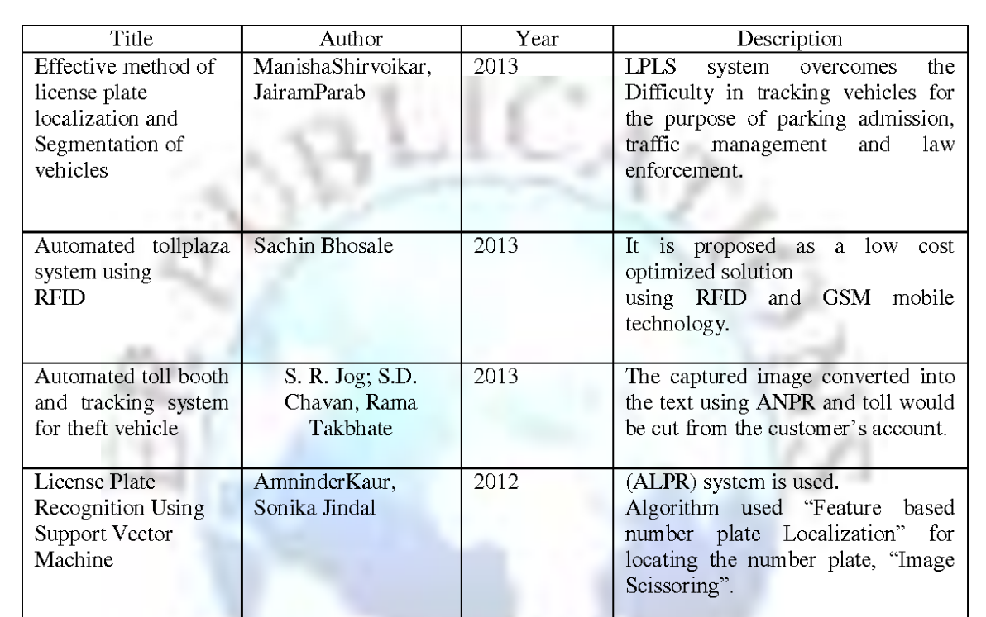

Slide 9
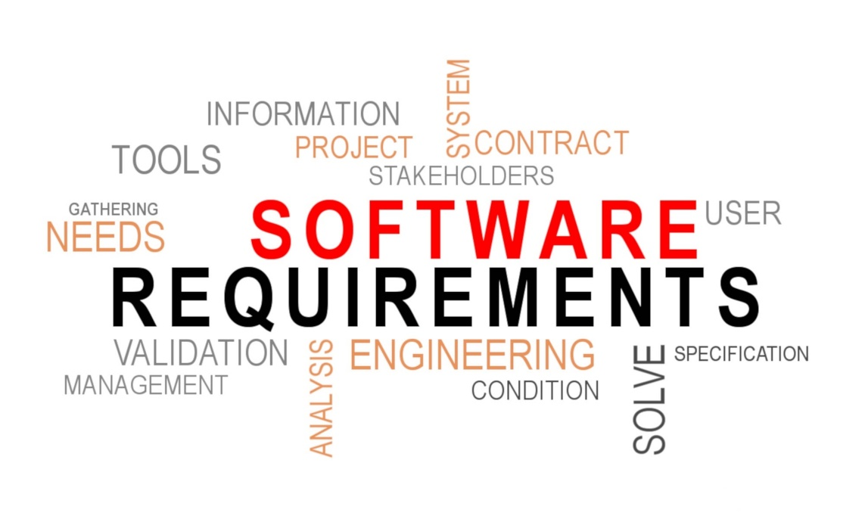
Software Required
Operating System:
Windows 7,8,10
Linux
Application Software:
python,
OpenCV and Pytesseract pip3 python package

Slide 10

Hardware Required
Processor: Minimum 1.7 GHz; Recommended 2GHz or more.
Ethernet connection (LAN) OR a wireless adapter (Wi-Fi)
Hard Drive: Minimum 32 GB; Recommended 64 GB or more.
Memory (RAM): Minimum 1 GB; Recommended 2 GB or above

Slide 11
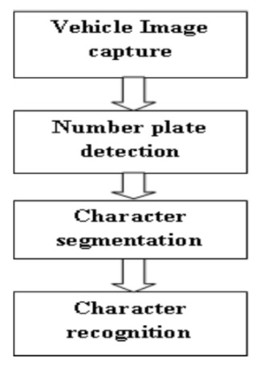
Development Methodology Used

Slide 12
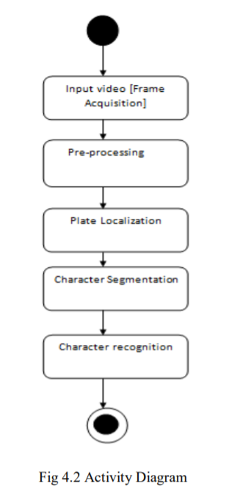
Activity Diagram

Slide 13
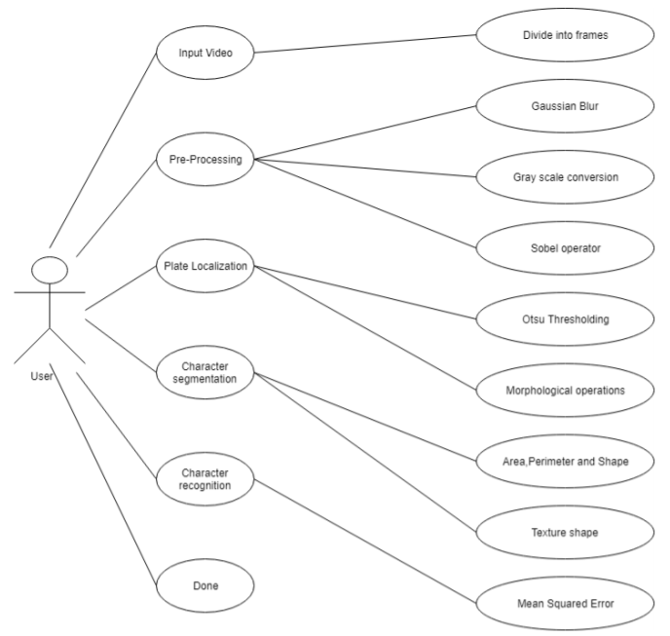
USE CASE DIAGRAM

Slide 14
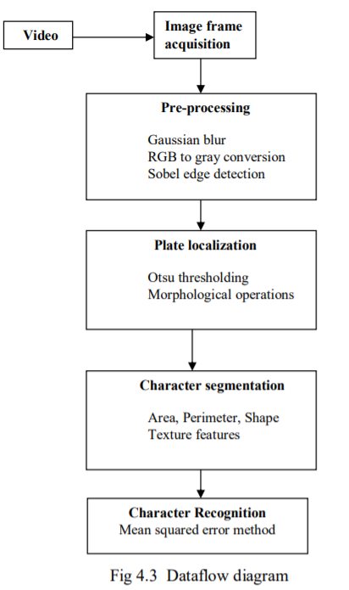
DATAFLOW DIAGRAM

Slide 15
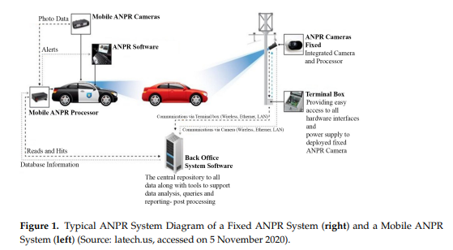
Proposed Method

Slide 16
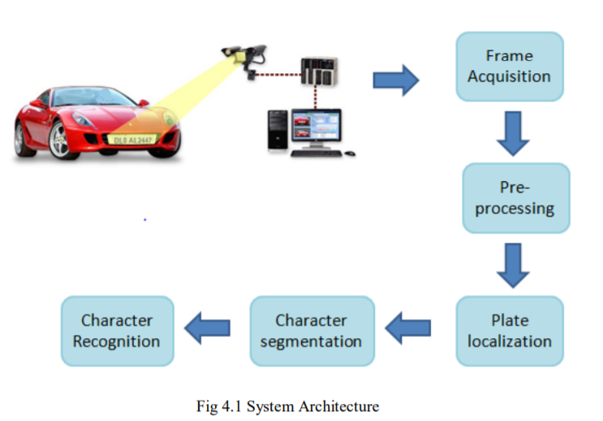
Proposed Method
In this python project, to identify the number plate in the input image, we will use following features of openCV:
Gaussian Blur: Here we use a Gaussian kernel to smoothen the image. This technique is highly effective to remove Gaussian noise. OpenCV provides a cv2.GaussianBlur() function for this task.
Sobel: Here we calculate the derivatives from the image. This feature is important for many computer vision tasks. Using derivatives we calculate the gradients, and a high change in gradient indicates a major change in the image. OpenCV provides a cv2.Sobel() function to calculate Sobel operators.

Slide 17
Proposed Method
Morphological Transformation: These are the operations based on image shapes and are performed on binary images. The basic morphological operations are Erosion, Dilation, Opening, Closing. The different functions provided in OpenCV are:
cv2.erode()
cv2.dilate()
cv2.morphologyEx()
Contours: Contours are the curves containing all the continuous points of same intensity. These are very useful tools for object recognition. OpenCV provides cv2.findContours() functions for this feature

Slide 18
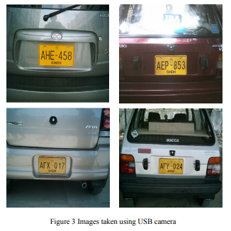
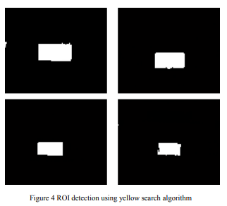
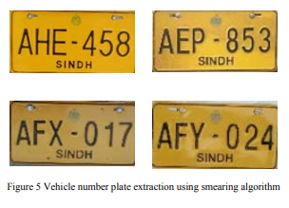
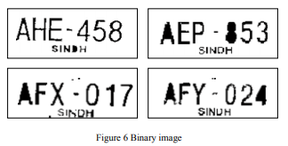
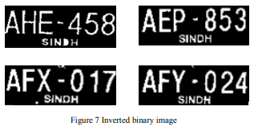
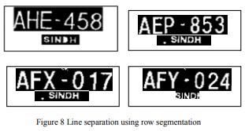
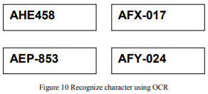
Working

Slide 19
Deliverables
It can be used to detect and prevent a wide range of criminal activities and for security control of a highly restricted areas like military zones or area around top government offices. The system is computationally inexpensive compare to the other ANPR systems.
The earlier methods use either feature based approached using edge detection or Hough transform which are computationally expensive or use artificial neural network which requires large training data.c

Slide 20
Gantt chart

Slide 21
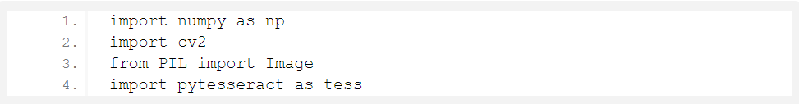
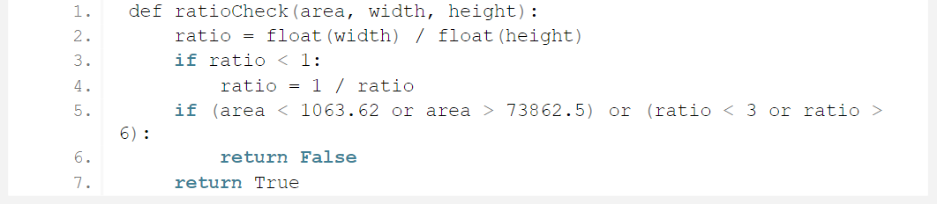
Source Code
1. Imports:
For this project we need numpy and pillow python libraries with openCV and pytesseract.
2.1. The first function to check the area range and width-height ratio:

Slide 22
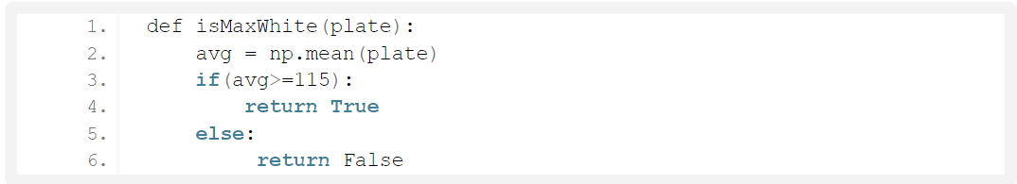
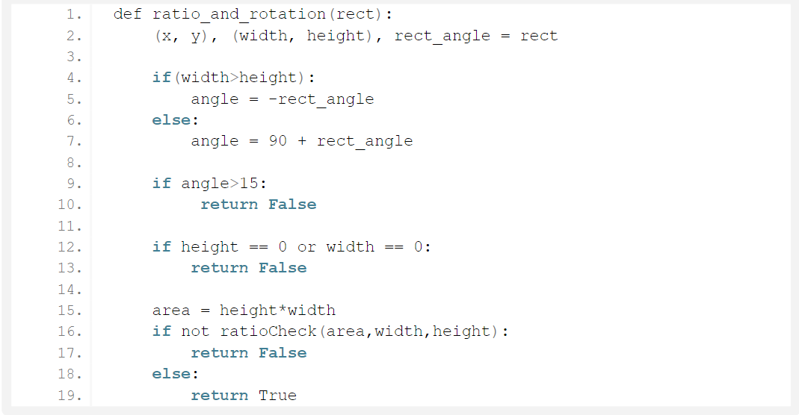
2.2. The second function to check average of image matrix:
2.3. The third function to check the rotation of contours:

Slide 23
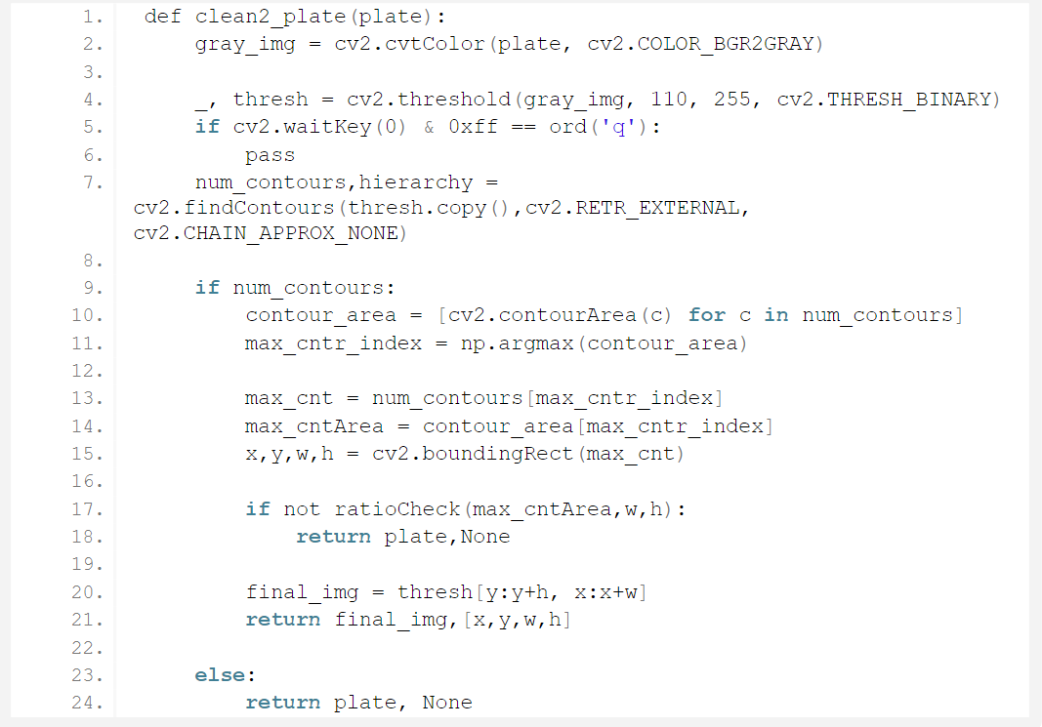
3. Now we will write a function to clean the identified number plate for preprocessing before feeding to pytesseract:

Slide 24
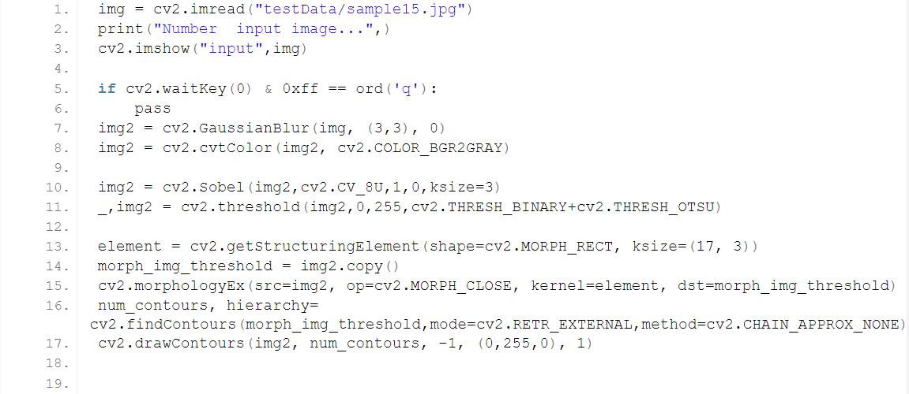
4. In this step, we will take an image input. We will perform Gaussian Blur, Sobel and morphological operations. After we find contours in the image and loop through each contour to identify the number plate. We will then clean the image contour and feed it to pytesseract to recognize the number and characters.

Slide 25
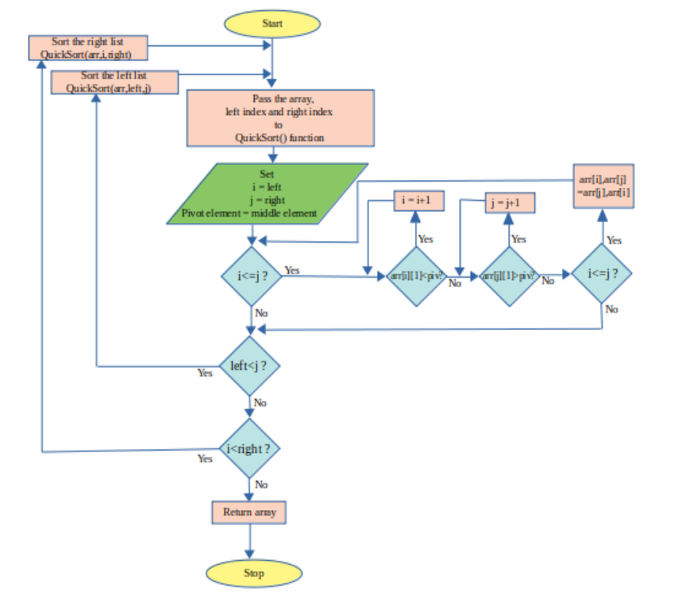
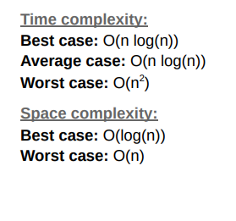
Quick Sort:
Flow Chart

Slide 26
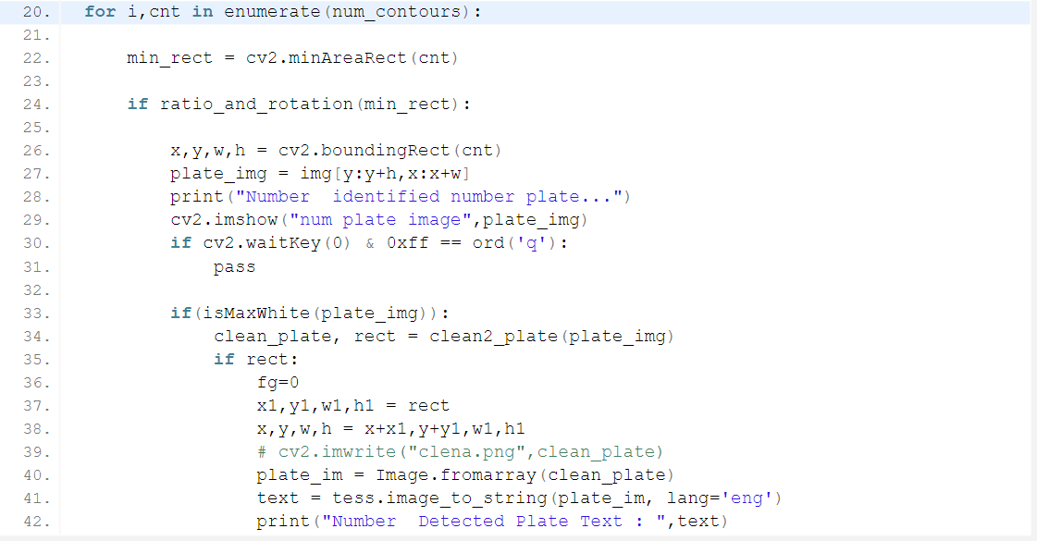

Slide 27
CONCLUSION
ANPR applications are becoming increasingly difficult in India's context for good performance developer growth in automotive, two-wheel drive and automotive industries. ANPR requests as default toll collection, automatic charging system in parking lots, management vehicles in the parking lot vacancies, and traffic monitoring, etc., have brought new research activities to ANPR size.
We have automatically upgraded the license plate recognition software by downloading input from live video feed. Character set is used for extraction number plates. Finally, separated letters are identified using an equal square error way.

Slide 28
Research paper status
Our research paper is accepted by our Project Guide.
Now we will publish it on scoups index journal/conference after some updates with the help of our Project Guide.

Slide 29
References
[1] Subhadhira,S., Juithonglang, U., Sakulkoo, P., &Horata, P. (2014). “License plate recognition application using extreme learning machines”, 2014 Third ICT International Student Project Conference (ICT-ISPC).doi:10.1109/ict-ispc.2014.6923228.
[2] Rahim Panahi and Iman Gholampour “Accurate Detection and Recognition of Dirty Vehicle Plate Numbers for High-Speed Applications, IEEE Transactions on intelligent transportation systems, vol. 18, no. 4, april2017.
[3] Quiros,A.R.F.,Bedruz,R.A.,Uy,A.C.,Abad,A.,Bandala,A.,Dadios,E.P.,Salle,D.L.(2017),”A KNN-based approach for the machine vision of character recognition of license plate numbers”, TENCON 2017 - 2017 IEEE Region 10 Conference.
[4] Leticia Fernandez sanchez, cranfield university, “Automatic number plate recognition System using machine learning techniques”, PHD Thesis, cranfielduniversity, 2017-18.
[5] Maulidia R. Hidayah1, Isa Akhlis2, Endang Sugiharti3” Recognition Number of The Vehicle Plate Using Otsu Method and K-Nearest Neighbour Classification”, Scientific Journal of Informatics Vol. 4, No. 1, May2017

Slide 30
[6] A. Hannun, “Sequence modeling with ctc,” Distill, 2017, https://distill.pub/2017/ctc. 3
[7] M. Abadi, A. Agarwal, P. Barham, E. Brevdo, Z. Chen, C. Citro, G. S. Corrado, A. Davis, J. Dean, M. Devin, S. Ghemawat, I. Goodfellow, A. Harp, G. Irving, M. Isard, Y. Jia, R. Jozefowicz, L. Kaiser, M. Kudlur, J. Levenberg, D. Mane, R. Monga, S. Moore, D. Murray, C. Olah, M. Schuster, J. Shlens, B. Steiner, I. Sutskever, K. Talwar, P. Tucker, V. Vanhoucke, V. Vasudevan, F. Viegas, O. Vinyals, P. Warden, M. Wattenberg, M. Wicke, Y. Yu, and X. Zheng, “TensorFlow: Large-Scale Machine Learning on Heterogeneous Distributed Systems,” arXiv:1603.04467 [cs], Mar. 2016, arXiv: 1603.04467. 3
[8] Y. Jia, E. Shelhamer, J. Donahue, S. Karayev, J. Long, R. Girshick, S. Guadarrama, and T. Darrell, “Caffe: Convolutional architecture for fast feature embedding,” arXiv preprint arXiv:1408.5093, 2014. 4
[9] U. Aydonat, S. O’Connell, D. Capalija, A. C. Ling, and G. R. Chiu, “An OpenCL(TM) Deep Learning Accelerator on Arria 10,” arXiv:1701.03534 [cs], Jan. 2017, arXiv: 1701.03534. 4
[10] “Intel OpenVINO Toolkit | Intel Software.” [Online]. Available: https://software.intel.com/en-us/articles/ OpenVINO-InferEngine 4

Slide 31

Thank You!
ALL FACULTY MEMBERS

